Slide 1
Informed Search

Slide 2


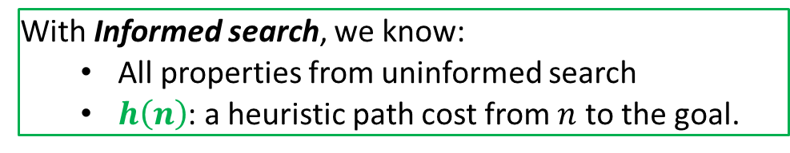
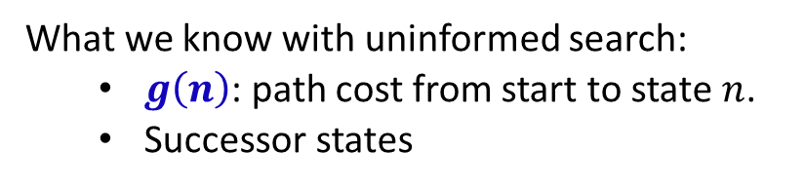

Uniformed Search vs. Informed Search
What we know with uninformed search:
  $g\left(n\right)$: path cost from start to state $n$.
  Successor states
goal
$$h\left(n\right)$$
start
$$n$$
$$g\left(n\right)$$
What if we had some guidance about which direction to search?
With Informed search, we know:
  All properties from uninformed search
  $h\left(n\right)$: a heuristic path cost from $n$ to the goal.

Slide 3



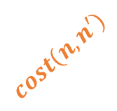



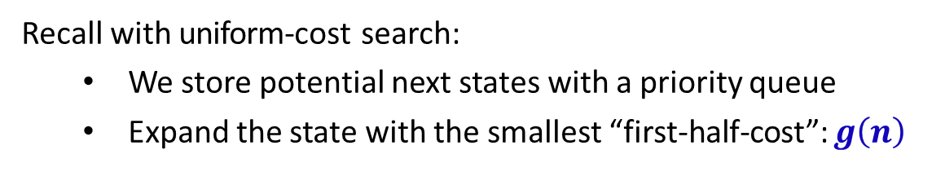



Using the Heuristic
Goal: speed up search using domain knowledge.
$$h\left(n′\right)$$
goal
$$n′$$
$$cost\left(n,n′\right)$$
start
$$n$$
$$n′′$$
$$h\left(n′′\right)$$
$$g\left(n\right)$$
$$cost\left(n,n′′\right)$$
Recall with uniform-cost search:
  We store potential next states with a priority queue
  Expand the state with the smallest “first-half-cost”: $g\left(n\right)$
$h\left(n\right)$ is a “second-half-cost”
How can we use $h\left(n\right)$?

Slide 4
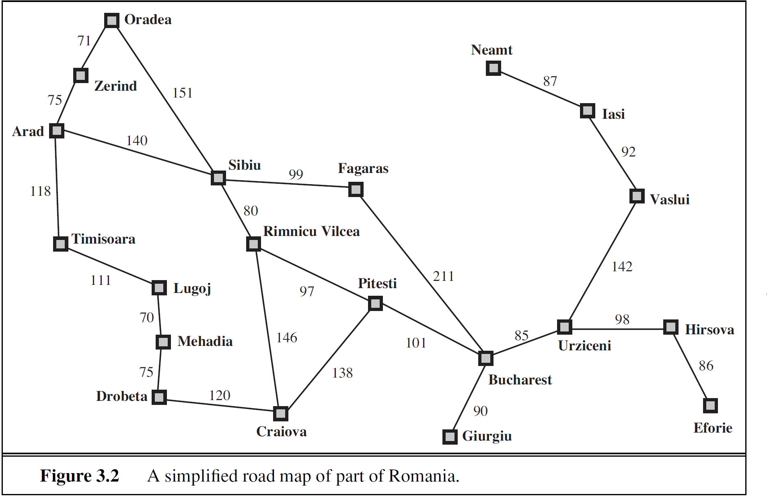
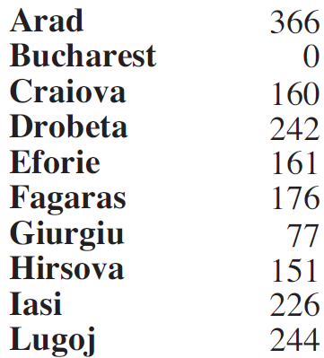
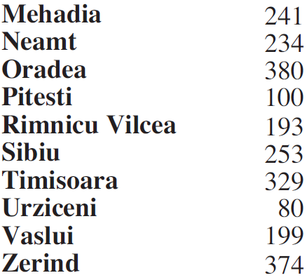

A Classic Example
Straight-line Distances to Bucharest
How does UCS proceed?
Recall, it minimizes $g\left(n\right)$.
Problem: Visit too many nodes, some clearly out of the question.
Visualizing UCS vs. A*

Slide 5


Attempt: Greedy Best-First
Approach: Choose smallest $h\left(n\right)$
Straight-line Distances to Bucharest
Arad → Sibiu → Rimnicu Vilcea → Pitesti

Slide 6

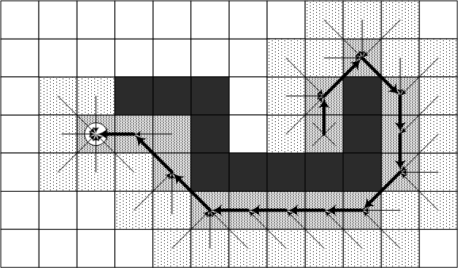

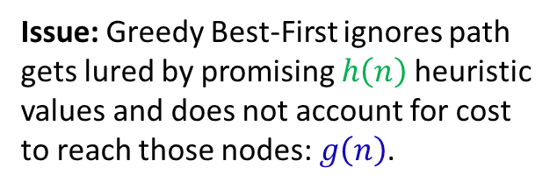
Greedy Best-First
Explore the grid expanding node with shortest distance to goal.
Complete?
*assuming no cycles
Optimal?
Optimal path
Start
Goal
Issue: Greedy Best-First ignores path gets lured by promising $h\left(n\right)$heuristic values and does not account for cost to reach those nodes: $g\left(n\right)$.

Slide 7











A* Search By Example
Approach: Expand smallest $g\left(n\right)+h\left(n\right)$
Straight-line Distances to Bucharest
$$450+0=450$$
$$418+0=418$$
$$366+160=526$$
$$455+160=615$$
$$239+176=415$$
$$317+100=417$$
$$220+193=413$$
$$140+253=393$$
$$118+329=447$$
$$75+374=449$$

Slide 8
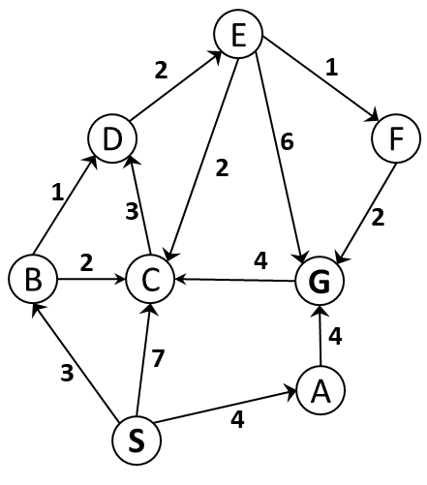




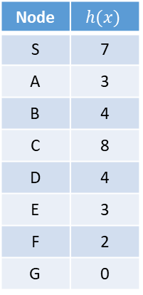





Quick Example
$$S$$
Node | $$h(x)$$
S | 7
A | 3
B | 4
C | 8
D | 4
E | 3
F | 2
G | 0
A
B
C
$$4+3=7$$
$$3+4=7$$
$$7+8=15$$
G
C
D
$$8+0=8$$
$$5+8=13$$
$$4+4=8$$
E
$$6+3=9$$
For A* choose minimal $f(n)=g\left(n\right)+h\left(n\right)$

Slide 9

Heuristic Properties: A Roadmap
A* is only as good as its heuristic. But what makes a "good" heuristic?
We consider three key properties of heuristics:
Dominance → Helps us choose between multiple admissible heuristics
  Given several valid heuristics, which one performs best?
Admissibility → Ensures A* finds optimal solutions
  Without this, A may return suboptimal paths*
Consistency → Enables more efficient search
  Allows A to avoid redundant work*
Goal: Design / select heuristics that make A* both optimal and efficient.

Slide 10
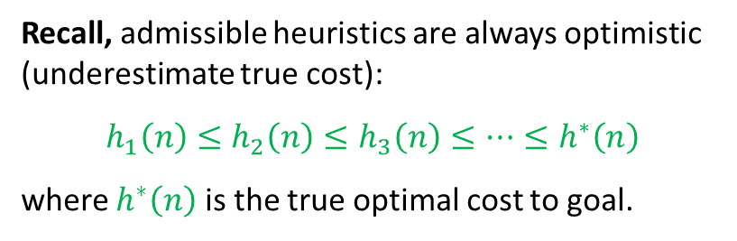
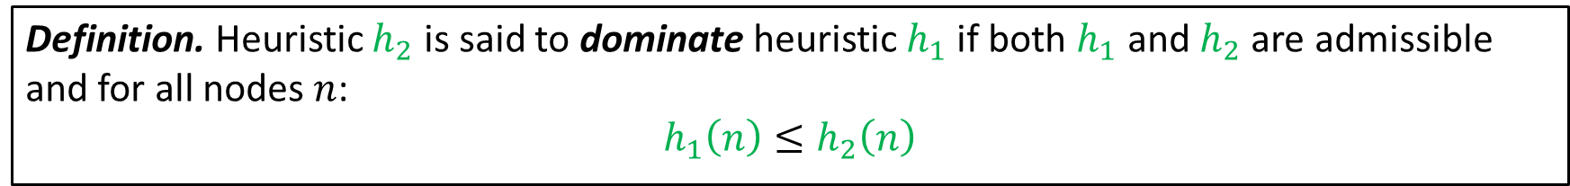
Heuristic Dominance
We have considered how different algorithms trade off optimality, completeness, and efficiency. But how can we evaluate the effectiveness of our heuristic?
That is, if we are using A*, how do we choose between different admissible heuristics?
Definition. Heuristic $h_{2}$ is said to dominate heuristic $h_{1}$ if both $h_{1}$ and $h_{2}$ are admissible and for all nodes $n$:
$$h_{1}\left(n\right)≤h_{2}\left(n\right)$$
Recall, admissible heuristics are always optimistic (underestimate true cost):
$$h_{1}\left(n\right)≤h_{2}\left(n\right)≤h_{3}\left(n\right)≤…≤h^{∗}\left(n\right)$$
where $h^{∗}\left(n\right)$ is the true optimal cost to goal.
→ a dominating heuristic gives us estimates closer to the real costs (that are still admissible).
Having dominant heuristics is important!
More accurate estimates → better guidance → fewer wrong paths explored

Slide 11
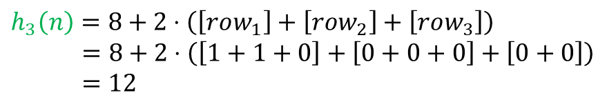
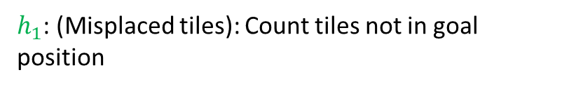

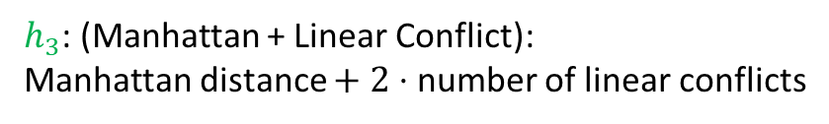
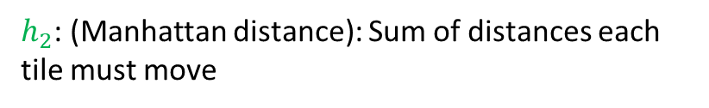
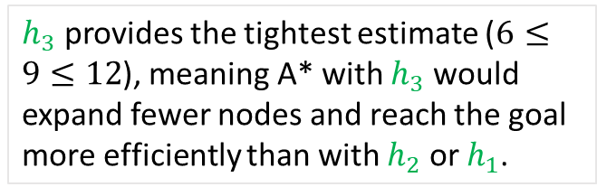
Heuristic Dominance: Example
8-puzzle: may only slide tiles into the empty space (no jumping or diagonal moves).
$h_{1}$: (Misplaced tiles): Count tiles not in goal position
$$h_{1}\left(n\right)=1+1+1+1+0+0+1+1=6$$
Challenge: Find the minimum sequence of moves to reach the goal state from any given starting configuration.
$h_{2}$: (Manhattan distance): Sum of distances each tile must move
$$h_{2}\left(n\right)=1+1+2+1+0+0+1+2=8$$
3 | 1 | 2
7 | 5 | 6
8 | 4
1 | 2 | 3
4 | 5 | 6
7 | 8
$h_{3}$: (Manhattan + Linear Conflict):
Manhattan distance $+ 2⋅$ number of linear conflicts
They are in the correct row/column.
A pairwise comparison indicates they are not in correct relative order.
Each conflict adds 2 to the heuristic indicating the minimum moves needed to resolve the conflict.
Two tiles are in linear conflict if:
Example State: $n$
Goal State
$h_{3}$ provides the tightest estimate ($6≤9≤12$), meaning A* with $h_{3}$ would expand fewer nodes and reach the goal more efficiently than with $h_{2}$ or $h_{1}$.
$$h_{3}\left(n\right)=8+2⋅\left(\left[row_{1}\right]+\left[row_{2}\right]+\left[row_{3}\right]\right)$$
$$=8+2⋅\left(\left[1+1+0\right]+\left[0+0+0\right]+\left[0+0\right]\right)$$
$$=12$$
(Observe no column conflicts here: no tiles are in their goal column but out of order.)

Slide 12


Admissible Heuristics
Under what conditions is A* guaranteed to find optimal solutions?
Definition. Heuristic $h\left(n\right)$ is admissible if:
$$0≤h\left(n\right)≤h^{∗}\left(n\right)$$
for all $n$ where $h^{∗}\left(n\right)$ is the true cost from $n$ to goal.
  Interpretation: $h\left(n\right)$ is admissible if it never overestimates the cost to reach the destination node.
Examples:
Examples?
Straight-line distance for route finding
Manhattan distance for grid worlds
Number of misplaced tiles for 8-puzzle
Minimum Spanning Tree in the Traveling Salesperson problem.
Number of attacking pairs: in the 8-Queens problem.
Max(horizontal distance, vertical distance)
Random numbers
Actual driving time (overestimates driving distance)

Slide 13














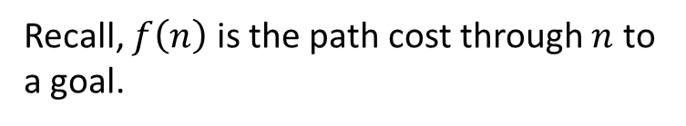

A* Proof of Optimality
$$f\left(n\right)=C>C^{∗}$$
$$S$$
…
$$n$$
…
$$G$$
Theorem. A*, with admissible heuristic, will find an optimal solution.
$$g^{∗}\left(n\right)$$
$$h^{∗}\left(n\right)$$
Proof by Contradiction.
$$C^{∗}=g^{∗}\left(n\right)+h^{∗}\left(n\right)$$
Suppose the optimal path has cost $C^{∗}$, but A* returns a suboptimal path with cost $f\left(n\right)=C>C^{∗}$.
Then there must be some node $n$ which is on the optimal path and is unexpanded (because if all the nodes on the optimal path had been expanded, then we would have returned that optimal solution).
Let $g^{∗}\left(n\right)$ be the cost of the optimal path from start to $n$ and $h^{∗}\left(n\right)$ be the cost of the optimal path from $n$ to the goal.
Recall, $f\left(n\right)$ is the path cost through $n$ to a goal.
$$f\left(n\right)=g\left(n\right)+h\left(n\right)$$
$$=g^{∗}\left(n\right)+h\left(n\right)$$
Since $n$ is on an optimal path
$$≤g^{∗}\left(n\right)+h^{∗}\left(n\right)$$
Admissability: ${h\left(n\right)≤h}^{∗}\left(n\right)$
$$≤C^{∗}$$
By definition, $C^{∗}=g^{∗}\left(n\right)+h^{∗}\left(n\right)$
However, our assumption was $f\left(n\right)>C^{∗}$.

Slide 14
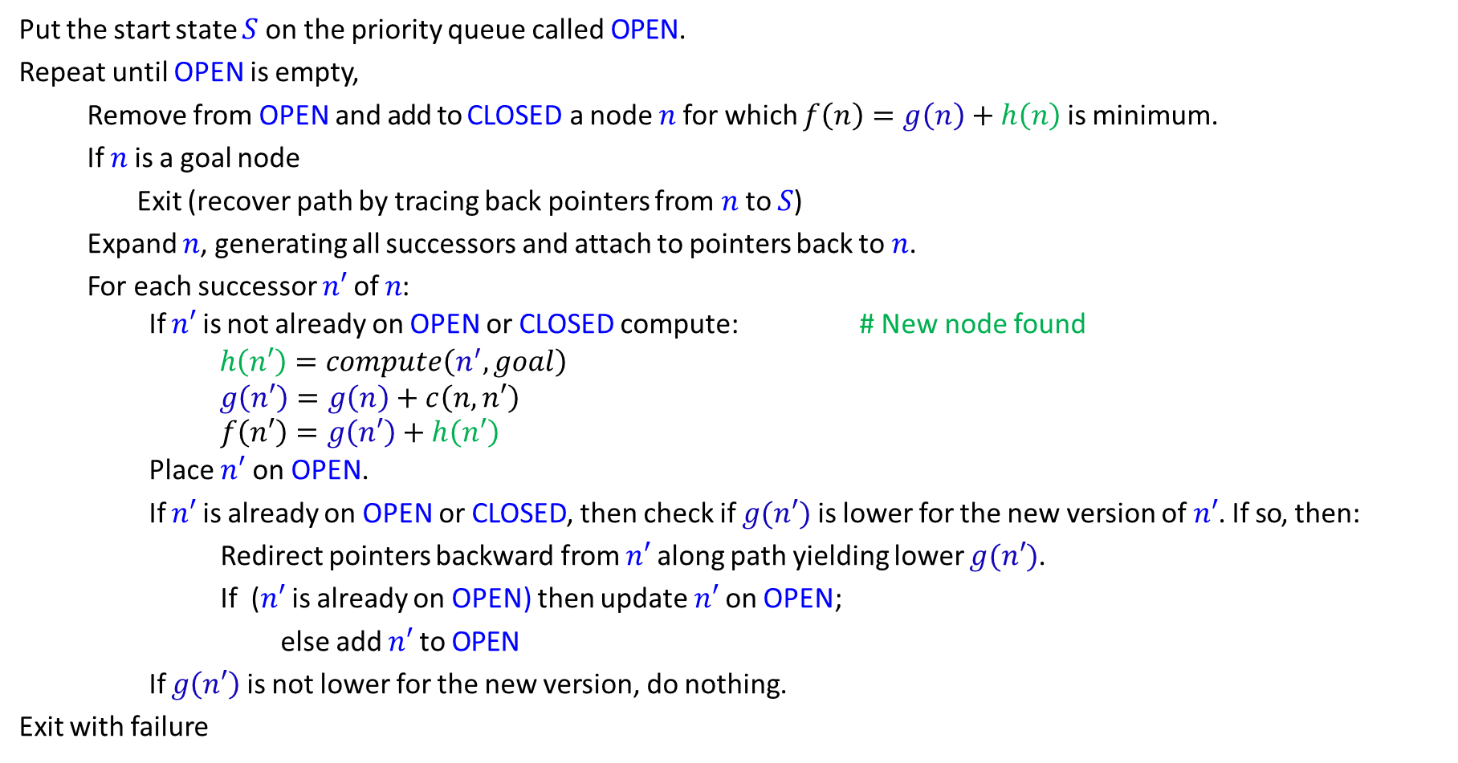
Full A* Algorithm
Put the start state $S$ on the priority queue called OPEN.
Repeat until OPEN is empty,
Remove from OPEN and add to CLOSED a node $n$ for which $f\left(n\right)=g\left(n\right)+h\left(n\right)$ is minimum.
If $n$ is a goal node
Exit (recover path by tracing back pointers from $n$ to $S$)
Expand $n$, generating all successors and attach to pointers back to $n$.
For each successor $n′$ of $n$:
If $n′$ is not already on OPEN or CLOSED compute: # New node found
    $$h\left(n′\right)=compute\left(n^{′}, goal\right)$$
    $$g\left(n′\right)=g\left(n\right)+c\left(n, n′\right)$$
      $$f\left(n′\right)=g\left(n′\right)+h\left(n′\right)$$
Place $n′$ on OPEN.
If $n′$ is already on OPEN or CLOSED, then check if $g(n′)$ is lower for the new version of $n′$. If so, then:
Redirect pointers backward from $n′$ along path yielding lower $g(n′)$.
If ($n′$ is already on OPEN) then update $n′$ on OPEN;
  else add $n′$ to OPEN
  If $g\left(n′\right)$ is not lower for the new version, do nothing.
Exit with failure
States already expanded

Slide 15



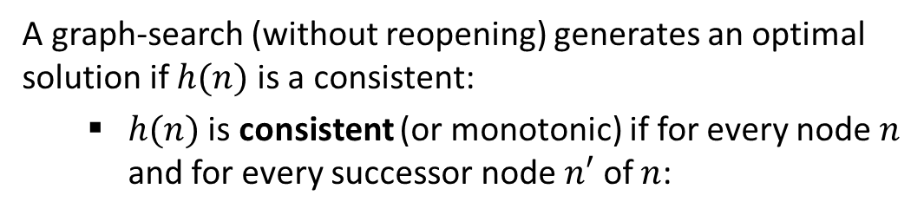





Consistency
$$n$$
$$h(n)$$
A graph-search (without reopening) generates an optimal solution if $h(n)$ is a consistent:
  $h(n)$ is consistent (or monotonic) if for every node $n$ and for every successor node $n′$ of $n$:
$$d$$
$$c(n,n’)$$
$$h(n’)$$
$$n’$$
$h(n)≤c(n,n’)+h(n’)$
(This is a form of triangle inequality.)
Example. Euclidean distance heuristic.
It represents the shortest possible path between two points, so the direct distance to the goal is always less than or equal to any indirect route through neighboring nodes.
$h(n)$ is consistent → $h(n)$ is admissible
With a consistent heuristic, the first time we reach a state, it will be on the optimal path. So we never have to re-add a state to the frontier (or check the CLOSED list).
(An inconsistent heuristic may end up with multiple paths reaching the same state.)

Slide 16
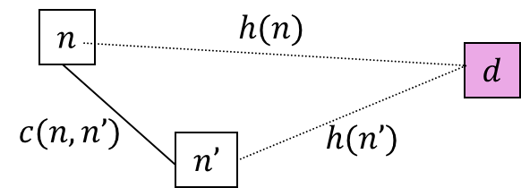








Inconsistent Example
$h(n)≤c(n,n’)+h(n’)$
Consider a situation where your GPS estimates distance to destination based on old road information.
Now imagine you are at Furman main entrance with 12 miles using surface roads to your destination: Cook Out.
You drive 2 miles to reach Timmons gate. From the Timmons gate, GPS discovered a more direct highway access that significantly shortens the remaining distance to Cook Out (only 8 miles left).
$$12$$
$$M$$
$$CO$$
$$2$$
$$T$$
$$8$$
?
Do we have consistency?
$$12≤2+8$$
No.

Slide 17
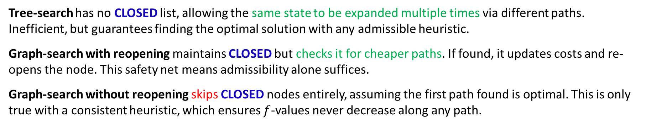
A* Optimality
A* Version | Requirement for Optimality | Notes
Tree-search | Admissible heuristic | No CLOSED list—can re-expand states.
Graph-search with reopening | Admissible heuristic | Checks CLOSED nodes for cheaper paths.
Graph-search without reopening | Consistent heuristic | Skips CLOSED nodes entirely.
Tree-search has no CLOSED list, allowing the same state to be expanded multiple times via different paths. Inefficient, but guarantees finding the optimal solution with any admissible heuristic.
Graph-search with reopening maintains CLOSED but checks it for cheaper paths. If found, it updates costs and re-opens the node. This safety net means admissibility alone suffices.
Graph-search without reopening skips CLOSED nodes entirely, assuming the first path found is optimal. This is only true with a consistent heuristic, which ensures $f$-values never decrease along any path.
Bottom line: Consistency enables efficiency; no reopening is needed when you are guaranteed the first path is best.

Slide 18
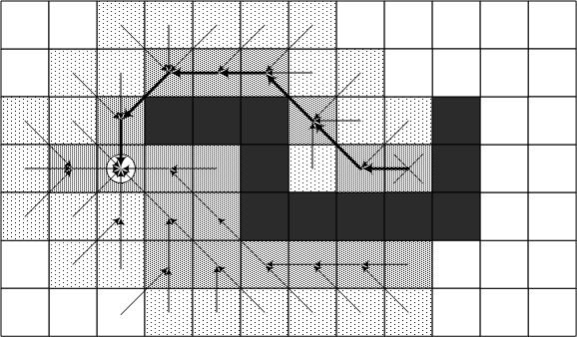
A* Avoids the Best-First Trap
Start
Goal

Slide 19
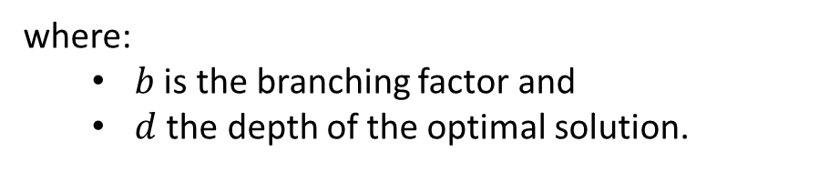


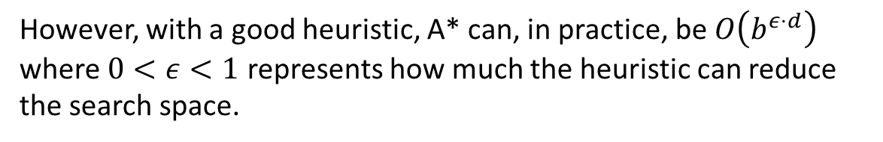
Brief A* Analysis
Time complexity:
$$O\left(b^{d}\right)$$
where:
  $b$ is the branching factor and
  $d$ the depth of the optimal solution.
However, with a good heuristic, A* can, in practice, be $O\left(b^{ε⋅d}\right)$ where $0<ε<1$ represents how much the heuristic can reduce the search space.
Space complexity:
$$O\left(b^{d}\right)$$
A* consumes lots of memory: $O\left(\#states\right)$ (OPEN, CLOSED, back-pointers). Thus, may run out on large problems.
If the heuristic can be consistent, we earn space efficiency by not re-adding nodes to the open list (by re-opening CLOSED nodes).

Slide 20


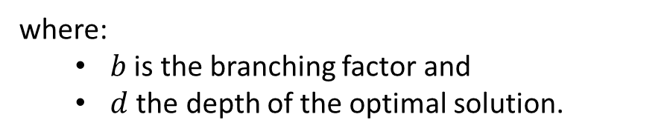
IDA*
We have encountered the problem of running out of memory before. Our solution to meld BFS and BFS was iterative deepening.
IDA*: incrementally increasing the maximum $f$-value $f\left(n\right)=g\left(n\right)+h\left(n\right)$
Time complexity:
$$O\left(b^{d}\right)$$
where:
  $b$ is the branching factor and
  $d$ the depth of the optimal solution.
Space complexity:
$$O\left(bd\right)$$
Complete?
with an admissible heuristic.
Optimal?
(Just as A*)

Slide 21



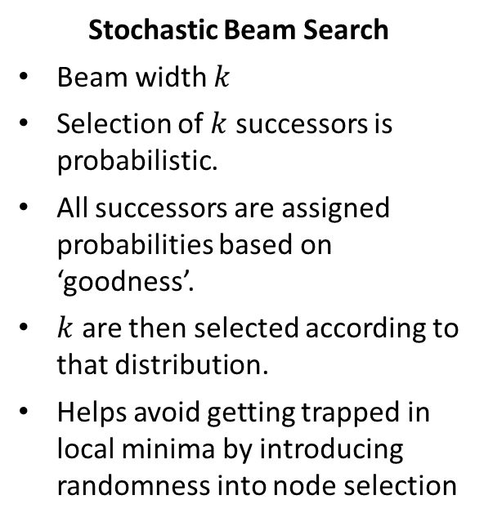
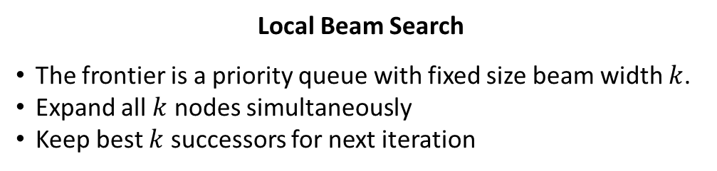
Beam Search
A* is optimal but uses exponential memory. IDA* is memory efficient but may re-explore nodes. What if we need something in between?
Motivation: Reduce memory usage by limiting frontier size while allowing our heuristic to guide us.
Local Beam Search
The frontier is a priority queue with fixed size beam width $k$.
Expand all $k$ nodes simultaneously
Keep best $k$ successors for next iteration
Stochastic Beam Search
Beam width $k$
Selection of $k$ successors is probabilistic.
All successors are assigned probabilities based on ‘goodness’.
$k$ are then selected according to that distribution.
Helps avoid getting trapped in local minima by introducing randomness into node selection
Complete?
Can discard (optimal) paths by keeping only locally promising nodes
Optimal?
Space?
$$O\left(k\right)$$
Optimal?
$$O\left(b^{d}\right)$$
Often, better due to beam width.

Slide 22



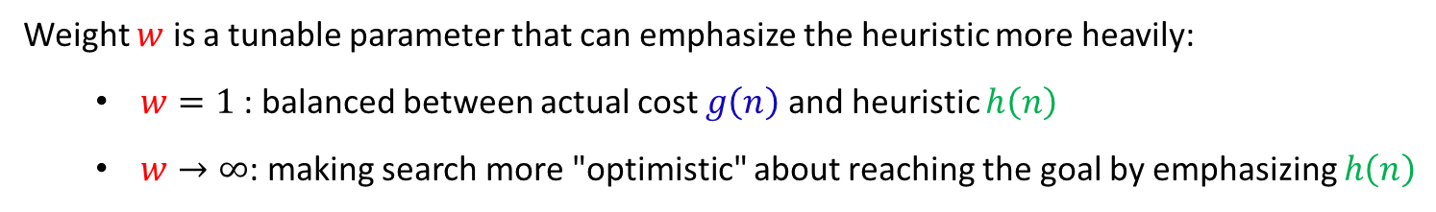

Beyond Optimal Search: Weighted A*
What if optimality is not worth the computational cost? Sometimes “good enough” solutions found quickly are better than optimal solutions found slowly.
Weighted A*: $f\left(n\right)=g\left(n\right)+w⋅h\left(n\right)$
where $w>1$
Weight $w$ is a tunable parameter that can emphasize the heuristic more heavily:
  $w=1$: balanced between actual cost $g\left(n\right)$ and heuristic $h\left(n\right)$
  $w→∞$: making search more "optimistic" about reaching the goal by emphasizing $h\left(n\right)$
Standard A*
Greedy Best-First
Complete?
Best-First and A* are complete; we are still using an admissible heuristic.
Optimal?
Solution cost is guaranteed to be $≤w⋅C^{∗}$where C* is optimal cost
Space?
$$O\left(bd\right)$$
Optimal?
$$O\left(b^{d}\right)$$
Often faster than A* in practice.
Used in real-time systems, video games, robotics.

Slide 23
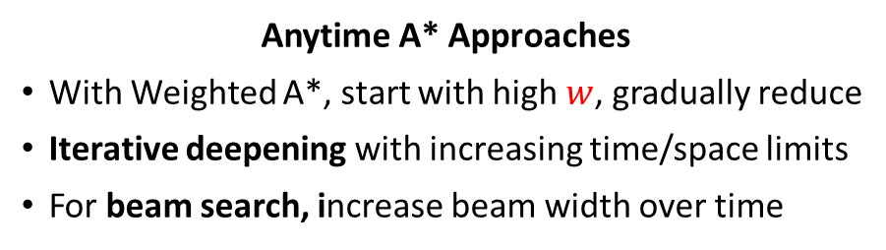
Beyond Optimal Search: Anytime Algorithms
What if we do not know how much time we have to search?
Common in game environments due to issues with frame rate.
Idea:
Start with a quick, possibly suboptimal solution
Improve solution quality over time if more time is available
Stop anytime and return current best solution
Graceful degradation: longer time → better solutions
Goal: Always have some answer ready.
Anytime A* Approaches
With Weighted A*, start with high $w$, gradually reduce
Iterative deepening with increasing time/space limits
For beam search, increase beam width over time
Properties
Interruptible: Can stop and return solution at any time
Monotonic improvement: Solution quality never decreases
Diminishing returns: Biggest improvements happen early
Games, online planning, real-time decision making

Slide 24
Practical Consideration: When To Use?
Algorithm | When to Use
Greedy Best-First | Quick approximate solutions Good heuristic available Optimality not important
A* | Need optimal solution Have good admissible heuristic Memory is available
IDA* | Need optimal solution Memory is limited Heuristic is good (low branching factor)
Beam Search | Large search spaces Optimal solution not required Time/memory constraints
Anytime Algorithms | Uncertain time constraints Need solution quickly, improve if time allows Real-time systems (games, robotics)

